Slide 1

ViT General Structure
Alex Pegoraro - UniTN

Slide 2
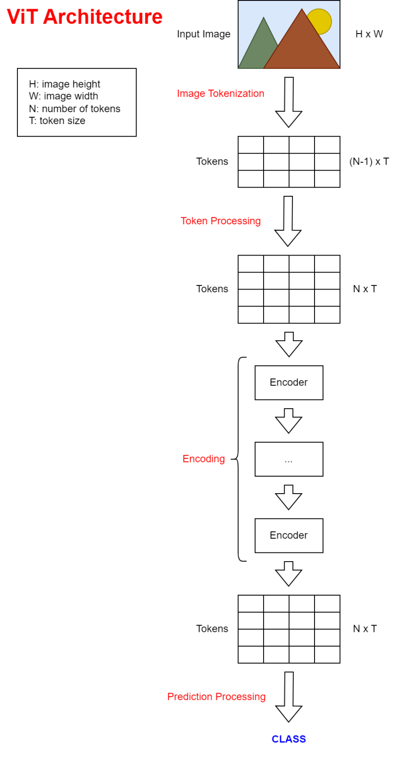
[1] Vision Transformers Explained
Alex Pegoraro - UniTN

Slide 3
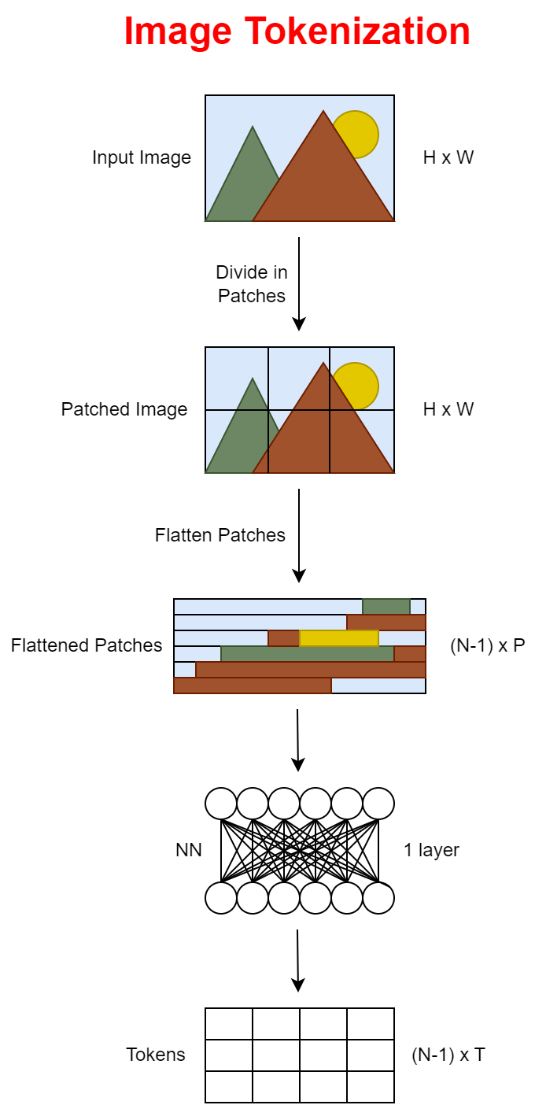
[1] Vision Transformers Explained
Alex Pegoraro - UniTN

Slide 4
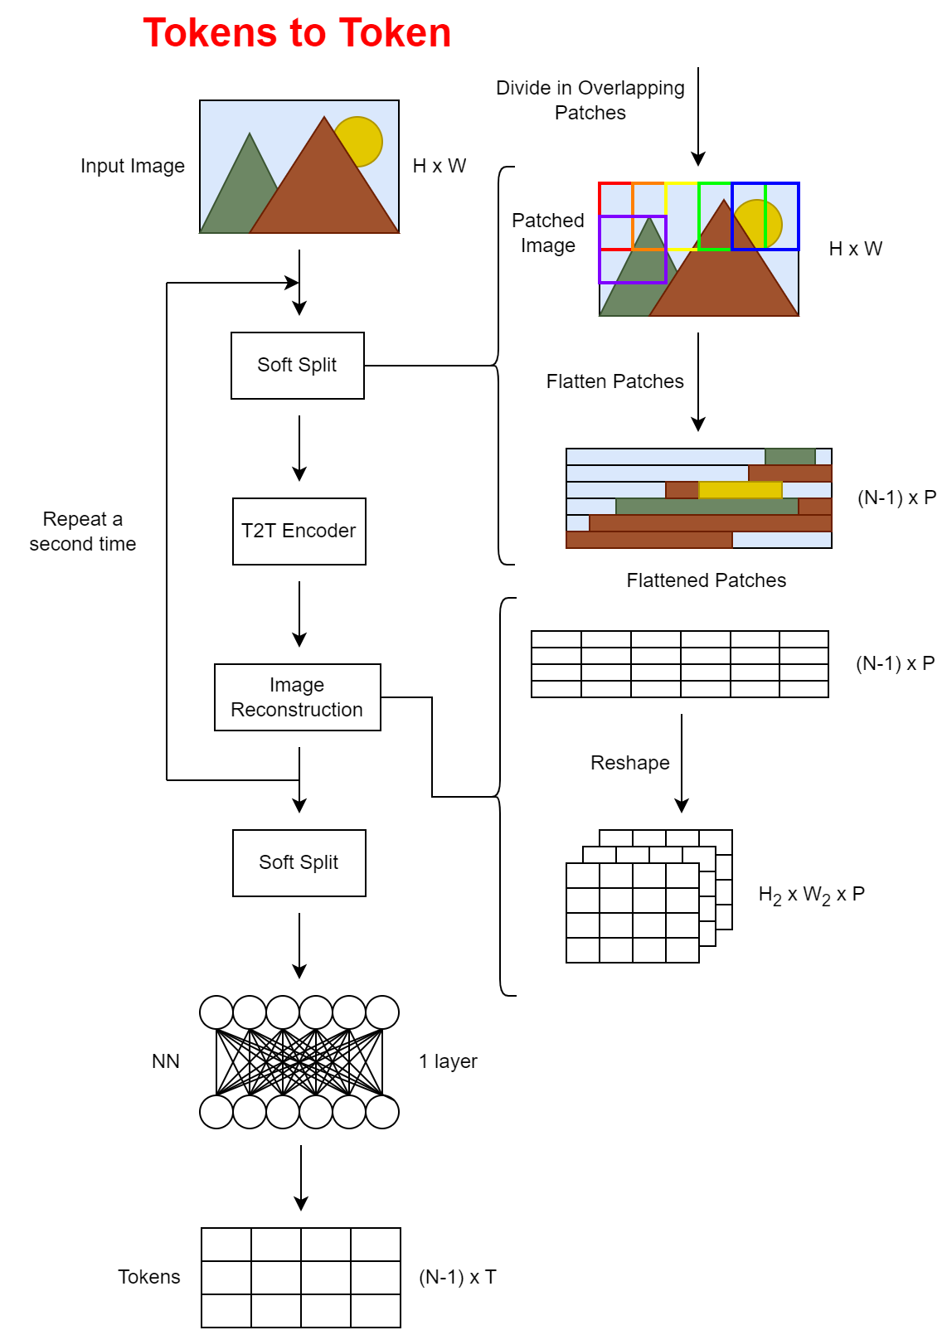
[1] Vision Transformers Explained
Alex Pegoraro - UniTN

Slide 5
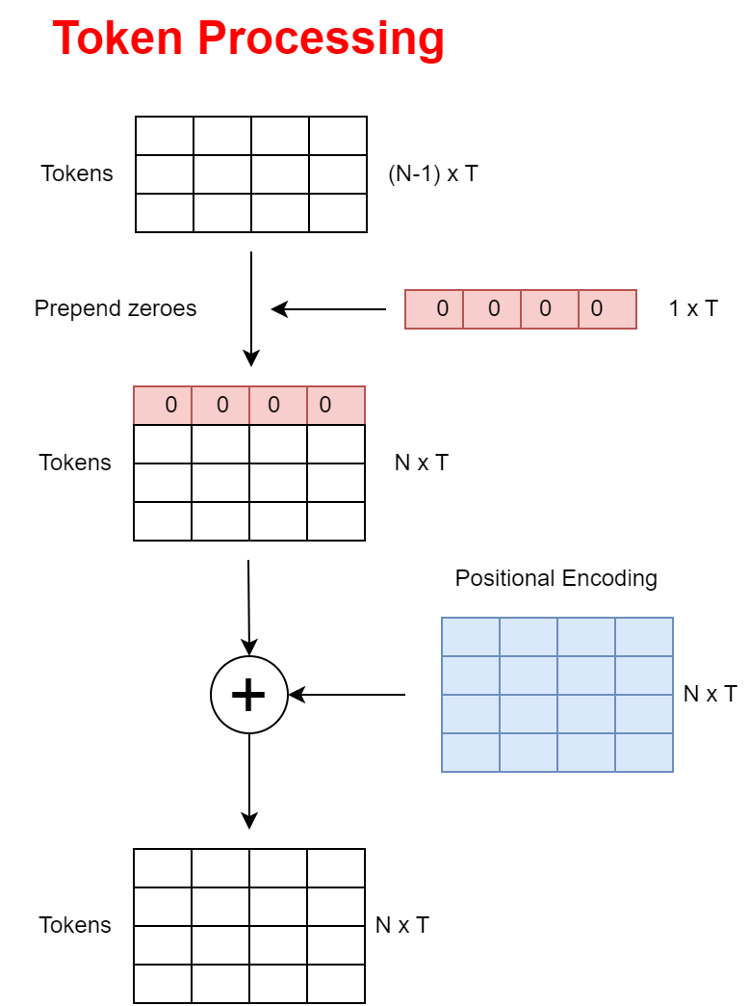
[1] Vision Transformers Explained
Alex Pegoraro - UniTN
Notes:
Riordinare le righe.

Slide 6
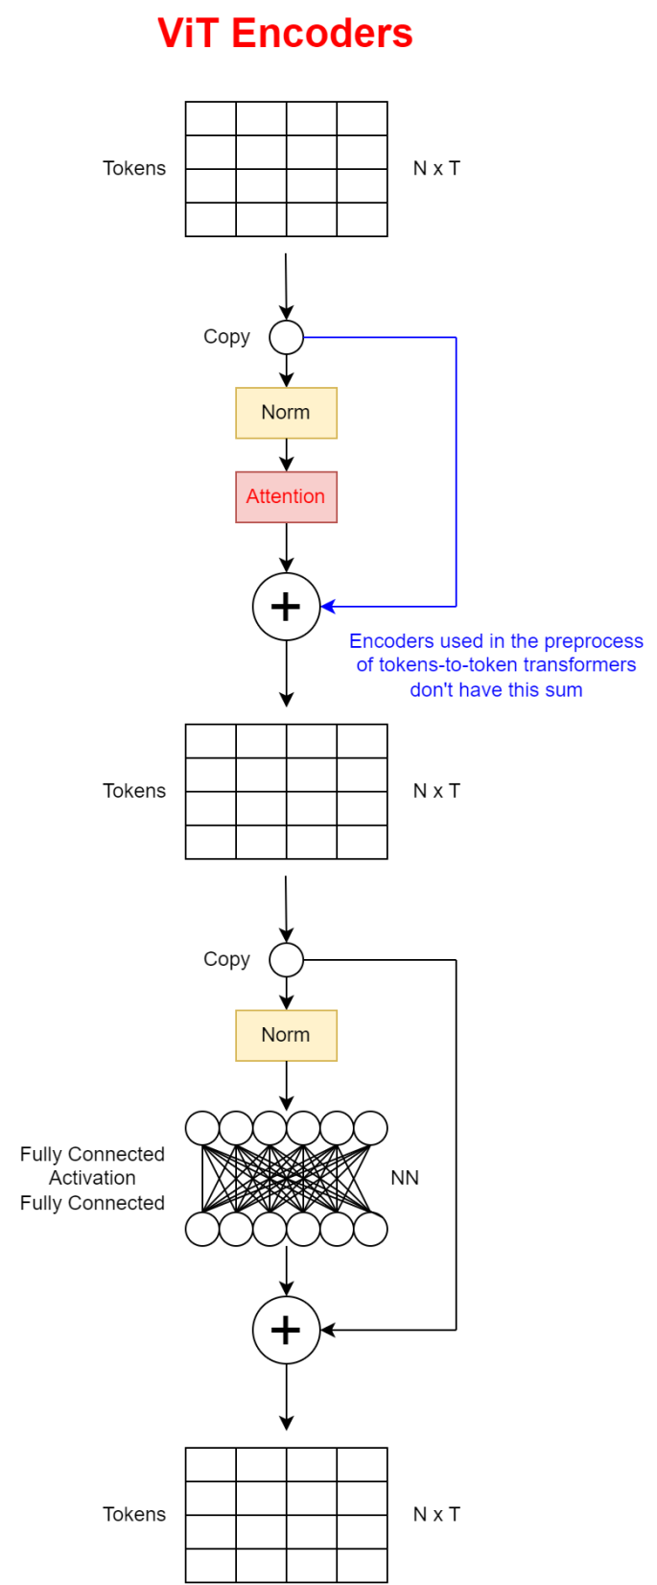
[1] Vision Transformers Explained
Alex Pegoraro - UniTN

Slide 7
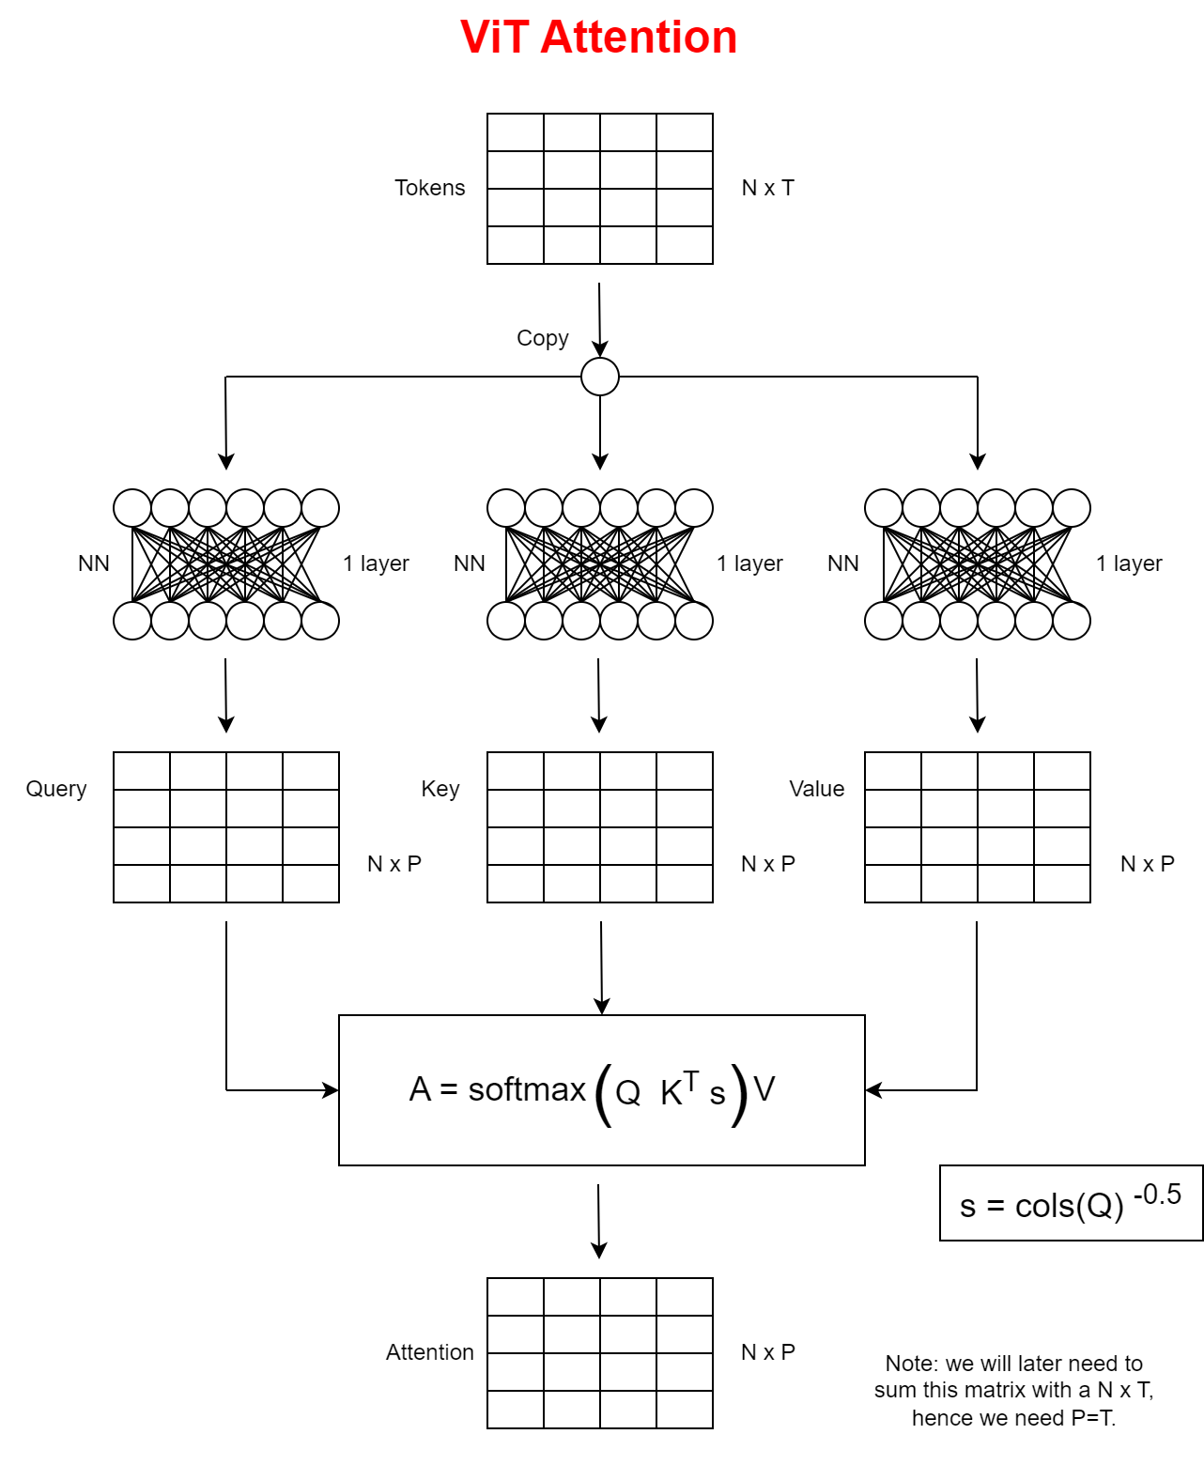
[1] Vision Transformers Explained
Alex Pegoraro - UniTN
Notes:
Scoprire struttura NN. (rappresentazione costante o variabile)

Slide 8
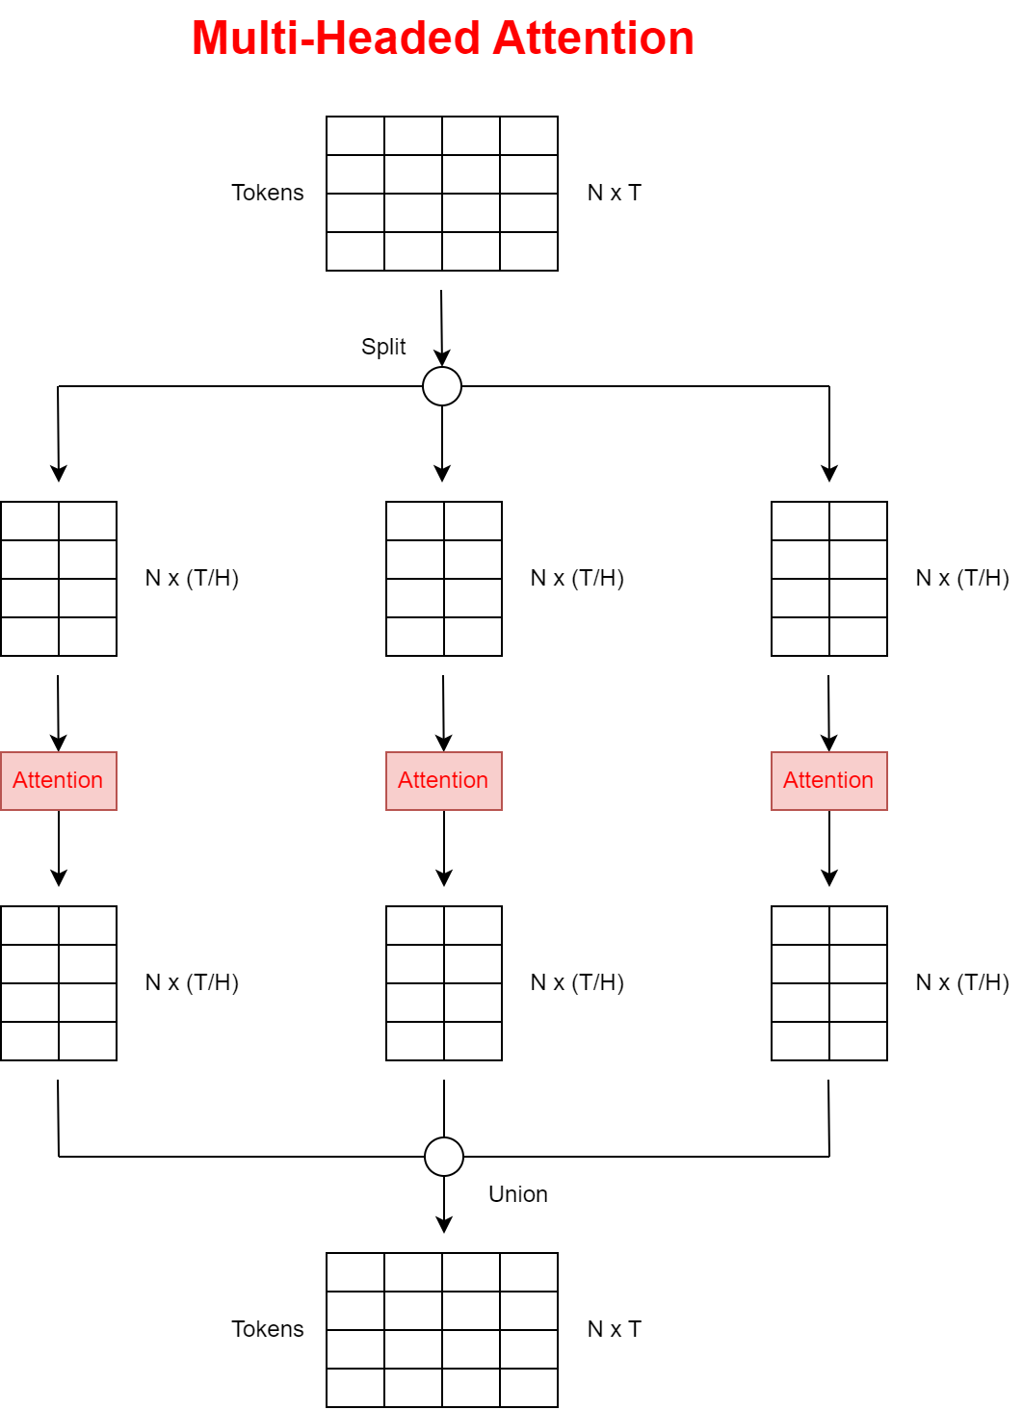
[1] Vision Transformers Explained
Alex Pegoraro - UniTN

Slide 9

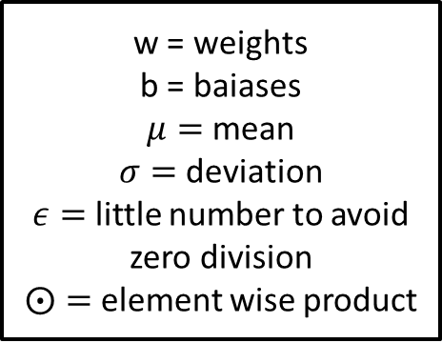
Layer Norm
[1] Vision Transformers Explained
$$Layernorm\left(x\right)=w ⨀\left(\frac{x−μ}{\sqrt{σ^{2}+ε}}\right)+b$$
w = weights
b = baiases
$μ=$ mean
$σ=$ deviation
$ε=$ little number to avoid zero division
$⨀=$ element wise product
This is done for every token, i.e. row of the matrix.
Alex Pegoraro - UniTN

Slide 10
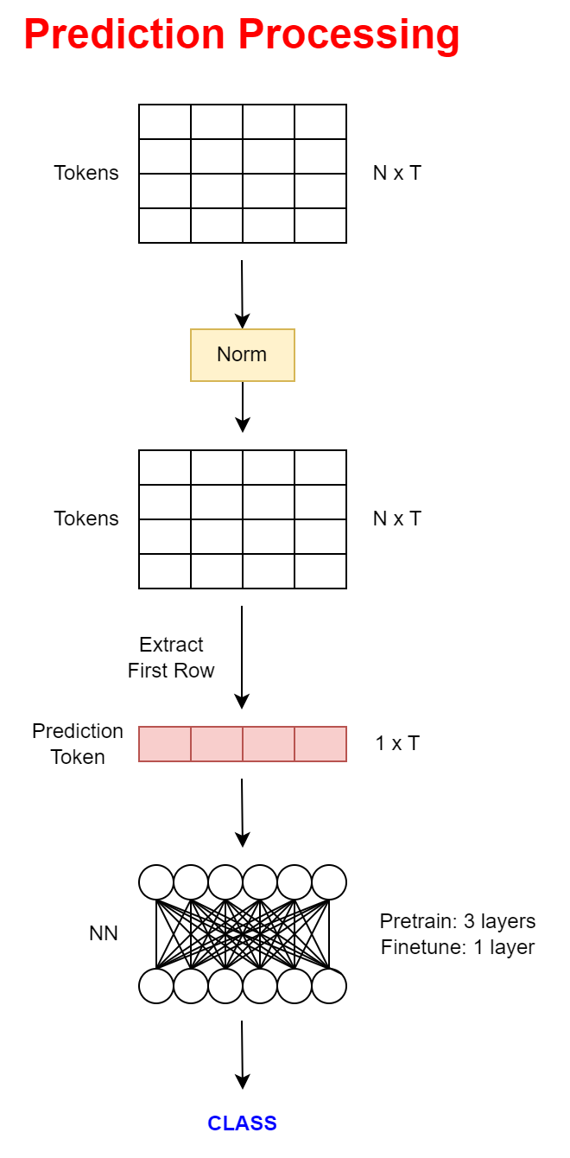
[1] Vision Transformers Explained
Alex Pegoraro - UniTN

Slide 11
Improvements
[6] The Era of 1-bit LLMs
[7] Towards Efficient Vision Transformer Inference
Memory:
Operator Fusion (not yet supported by frameworks)
Quantization (float32 -> int8), poor speedup in time
Inference time:
Structured Pruning (remove attention heads, FFNN layers)
Neural Architecture Search (NAS)
Both:
1 bit NN (-1, 0, 1)
Hybrids
Hierarchical Pooling, no class token
Knowledge distillation
Kernelization, low-rank decomposition, sparsification
New architectures and/or training techniques
Alex Pegoraro - UniTN

Slide 12
Observations
[6] The Era of 1-bit LLMs
[7] Towards Efficient Vision Transformer Inference
Transformers are computation intensive, and require more FLOPS than other models.
MatMul is the latency-dominating operator.
FFNN are more time-consuming than attention.
Common activation: GELU.
Nowadays, CNN-ViT hybrids are the best solutions.
self-attention mechanism has quadratic memory and computational complexity.
A model can be expanded in: depth, width, resolution, patch size.
Alex Pegoraro - UniTN

Slide 13
Hierarchical ViT
[8] Scalable Vision Transformers with Hierarchical Pooling
After any encoding stage, a MaxPool1D(Matrix, Kernel, Stride) is applied, altogether with a learnable positional encoding. That needs to be summed again.
The same paper deals with class token removal. Instead of layer-norm, extract-class-token, FFNN, the last pipeline stage becomes layer-norm, AvgPool, FFNN.
Alex Pegoraro - UniTN

Slide 14
Efficient ViT
[9] EfficientViT: Multi-Scale Linear Attention
Prior High-resolution dense prediction models used softmax attention (to have global receptive fields) and large kernel convolution (for multi scale learning), that are effective but inefficient.
This model substitute softmax attention with lightweight ReLU linear attention, reducing complexity from quadratic to linear.
It also replaces large Kernel convolutions with small ones. Nearby tokens are aggregated in multi-scale tokens. ReLU attention is then applied on them.
On the FFNN is added Depth Wise Convolution. Multi-Scale Linear Attention captures context info, FFNN + DWConv captures local ones.
Alex Pegoraro - UniTN

Slide 15

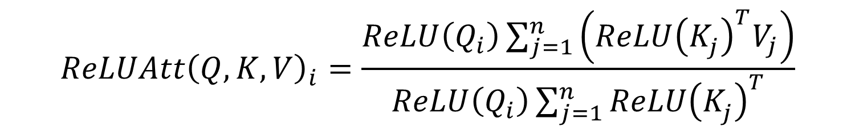
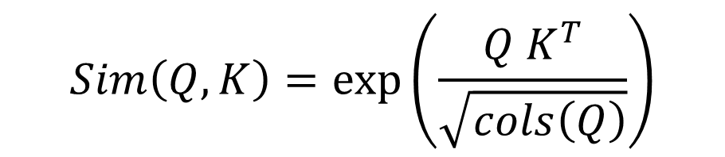
Efficient ViT
[9] EfficientViT: Multi-Scale Linear Attention
$$Att{\left(Q,K,V\right)}_{i}=\sum_{j=1}^{n}{\frac{Sim\left(Q_{i},K_{j}\right)}{\sum_{j=1}^{n}{Sim\left(Q_{i},K_{j}\right)}}V_{j}}$$
$$Sim\left(Q,K\right)=\exp\left(\frac{Q K^{T}}{\sqrt{cols\left(Q\right)}}\right)$$
Softmax attention:
ReLU attention:
$$Sim\left(Q,K\right)=ReLU\left(Q\right)ReLU{\left(K\right)}^{T}$$
$$ReLUAtt{\left(Q,K,V\right)}_{i}=\frac{ReLU\left(Q_{i}\right)\sum_{j=1}^{n}{\left(ReLU{\left(K_{j}^{}\right)}^{T}V_{j}\right)}}{ReLU\left(Q_{i}\right)\sum_{j=1}^{n}{ReLU{\left(K_{j}^{}\right)}^{T}}}$$
Alex Pegoraro - UniTN

Slide 16
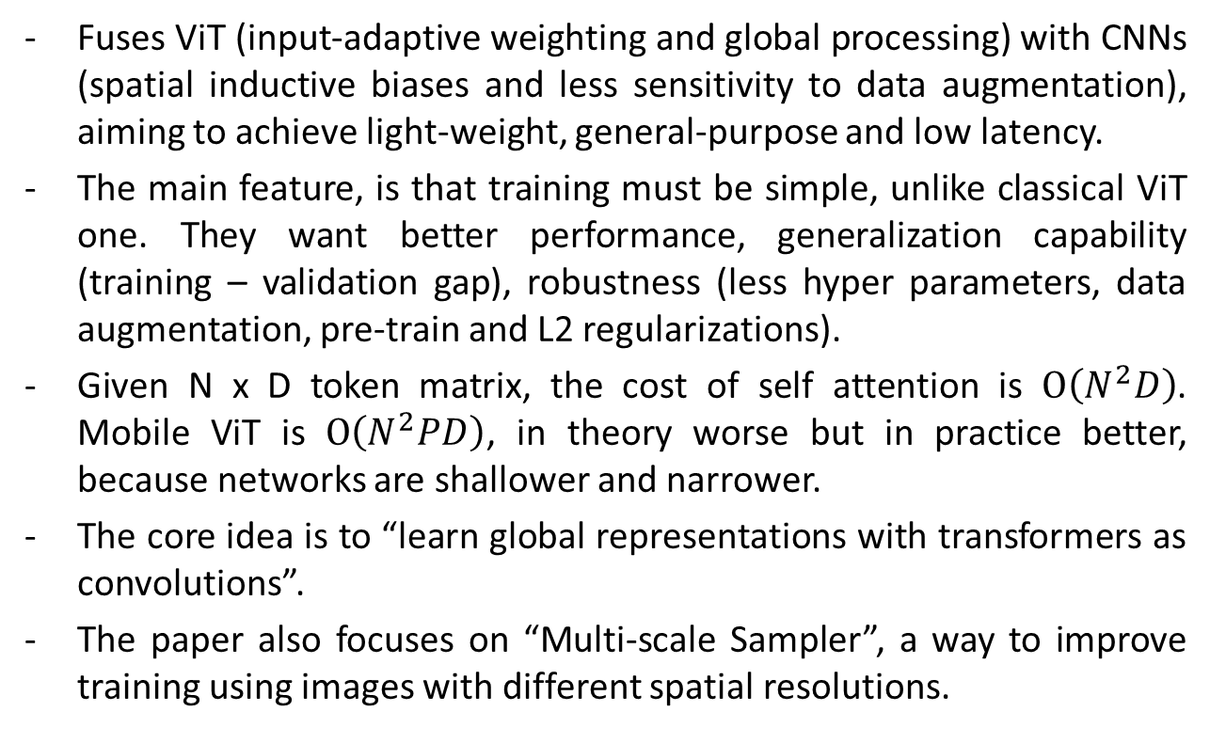
Mobile ViT
[10] MobileViT
Fuses ViT (input-adaptive weighting and global processing) with CNNs (spatial inductive biases and less sensitivity to data augmentation), aiming to achieve light-weight, general-purpose and low latency.
The main feature, is that training must be simple, unlike classical ViT one. They want better performance, generalization capability (training – validation gap), robustness (less hyper parameters, data augmentation, pre-train and L2 regularizations).
Given N x D token matrix, the cost of self attention is $O\left(N^{2}D\right)$. Mobile ViT is $O\left(N^{2}PD\right)$, in theory worse but in practice better, because networks are shallower and narrower.
The core idea is to “learn global representations with transformers as convolutions”.
The paper also focuses on “Multi-scale Sampler”, a way to improve training using images with different spatial resolutions.
Alex Pegoraro - UniTN

Slide 17
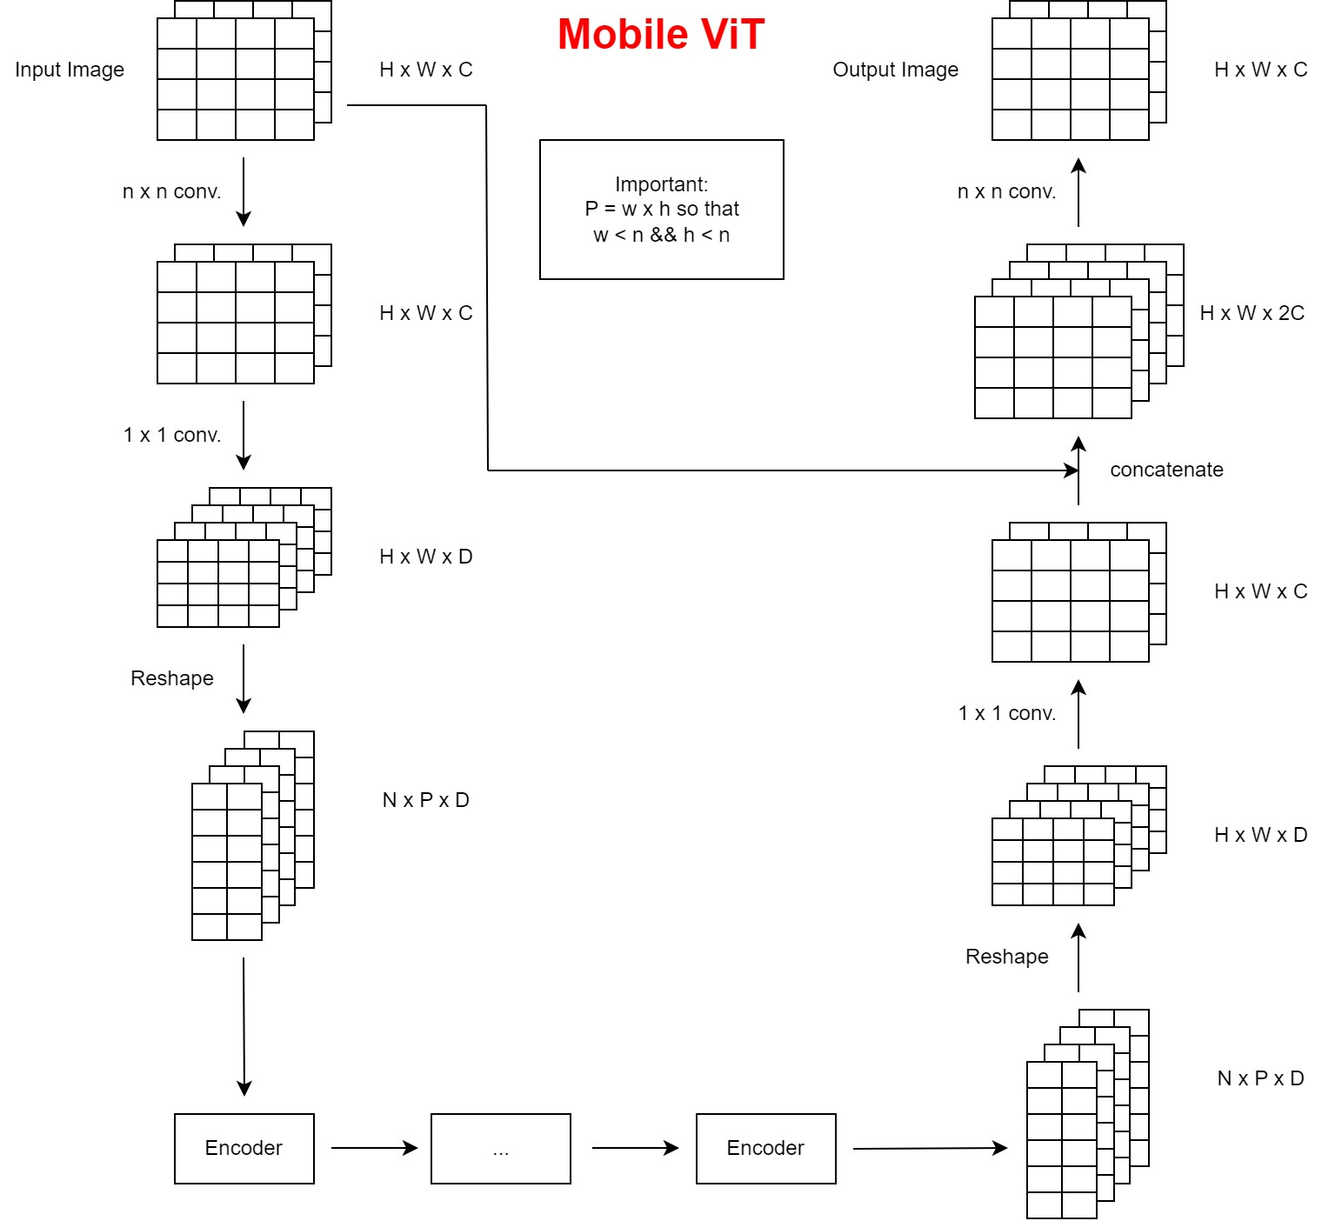
[10] MobileViT
Alex Pegoraro - UniTN

Slide 18
Paper References
[1] «Vision Transformers, Explained», Skylar Jean Callis, https://towardsdatascience.com/vision-transformers-explained-a9d07147e4c8
[2] «Transformers in Computer Vision», Bert Moons, https://www.axelera.ai/blog/transformers-in-computer-vision
[3] «Decoding Transformers on Edge Devices», Bert Moons, https://www.axelera.ai/blog/decoding-transformers-on-edge-devices
[4] «A Survey of Visual Transformers», Yang Liu, Yao Zhang, Yixin Wang, Feng Hou, Jin Yuan, Jiang Tian, Yang Zhang, Zhongchao Shi, Jianping Fan, Zhiqiang He
[5] «On-Device Training Under 256KB Memory», Ji Lin, Ligeng Zhu, Wei-Ming Chen, Wei-Chen Wang, Chuang Gan, Song Han
Alex Pegoraro - UniTN

Slide 19
Paper References
[6] «The Era of 1-bit LLMs: All Large Language Models are in 1.58 Bits», Shuming Ma, Hongyu Wang, Lingxiao Ma, Lei Wang, Wenhui Wang, Shaohan Huang, Li Dong, Ruiping Wang, Jilong Xue, Furu Wei
[7] «Towards Efficient Vision Transformer Inference: A First Study of Transformers on Mobile Devices», Xudong Wang, Li Lyna Zhang, Yang Wang, Mao Yang
[8] «Scalable Vision Transformers with Hierarchical Pooling», Zizheng Pan, Bohan Zhuang, Jing Liu, Haoyu He, Jianfei Cai
[9] «EfficientViT: Multi-Scale Linear Attention for High-Resolution Dense Prediction», Han Cai, Junyan Li, Muyan Hu, Chuang Gan, Song Han
[10] «MobileViT: Light-Weight, General-Purpose, and Mobile-Friendly Vision Transformer», Sachin Mehta, Mohammad Rastegari
Alex Pegoraro - UniTN

